Slide 1

Challenge your Smartness with BetterHOME
Team Alcofun
Elcathon, Zurich 15.10.2016

Slide 2
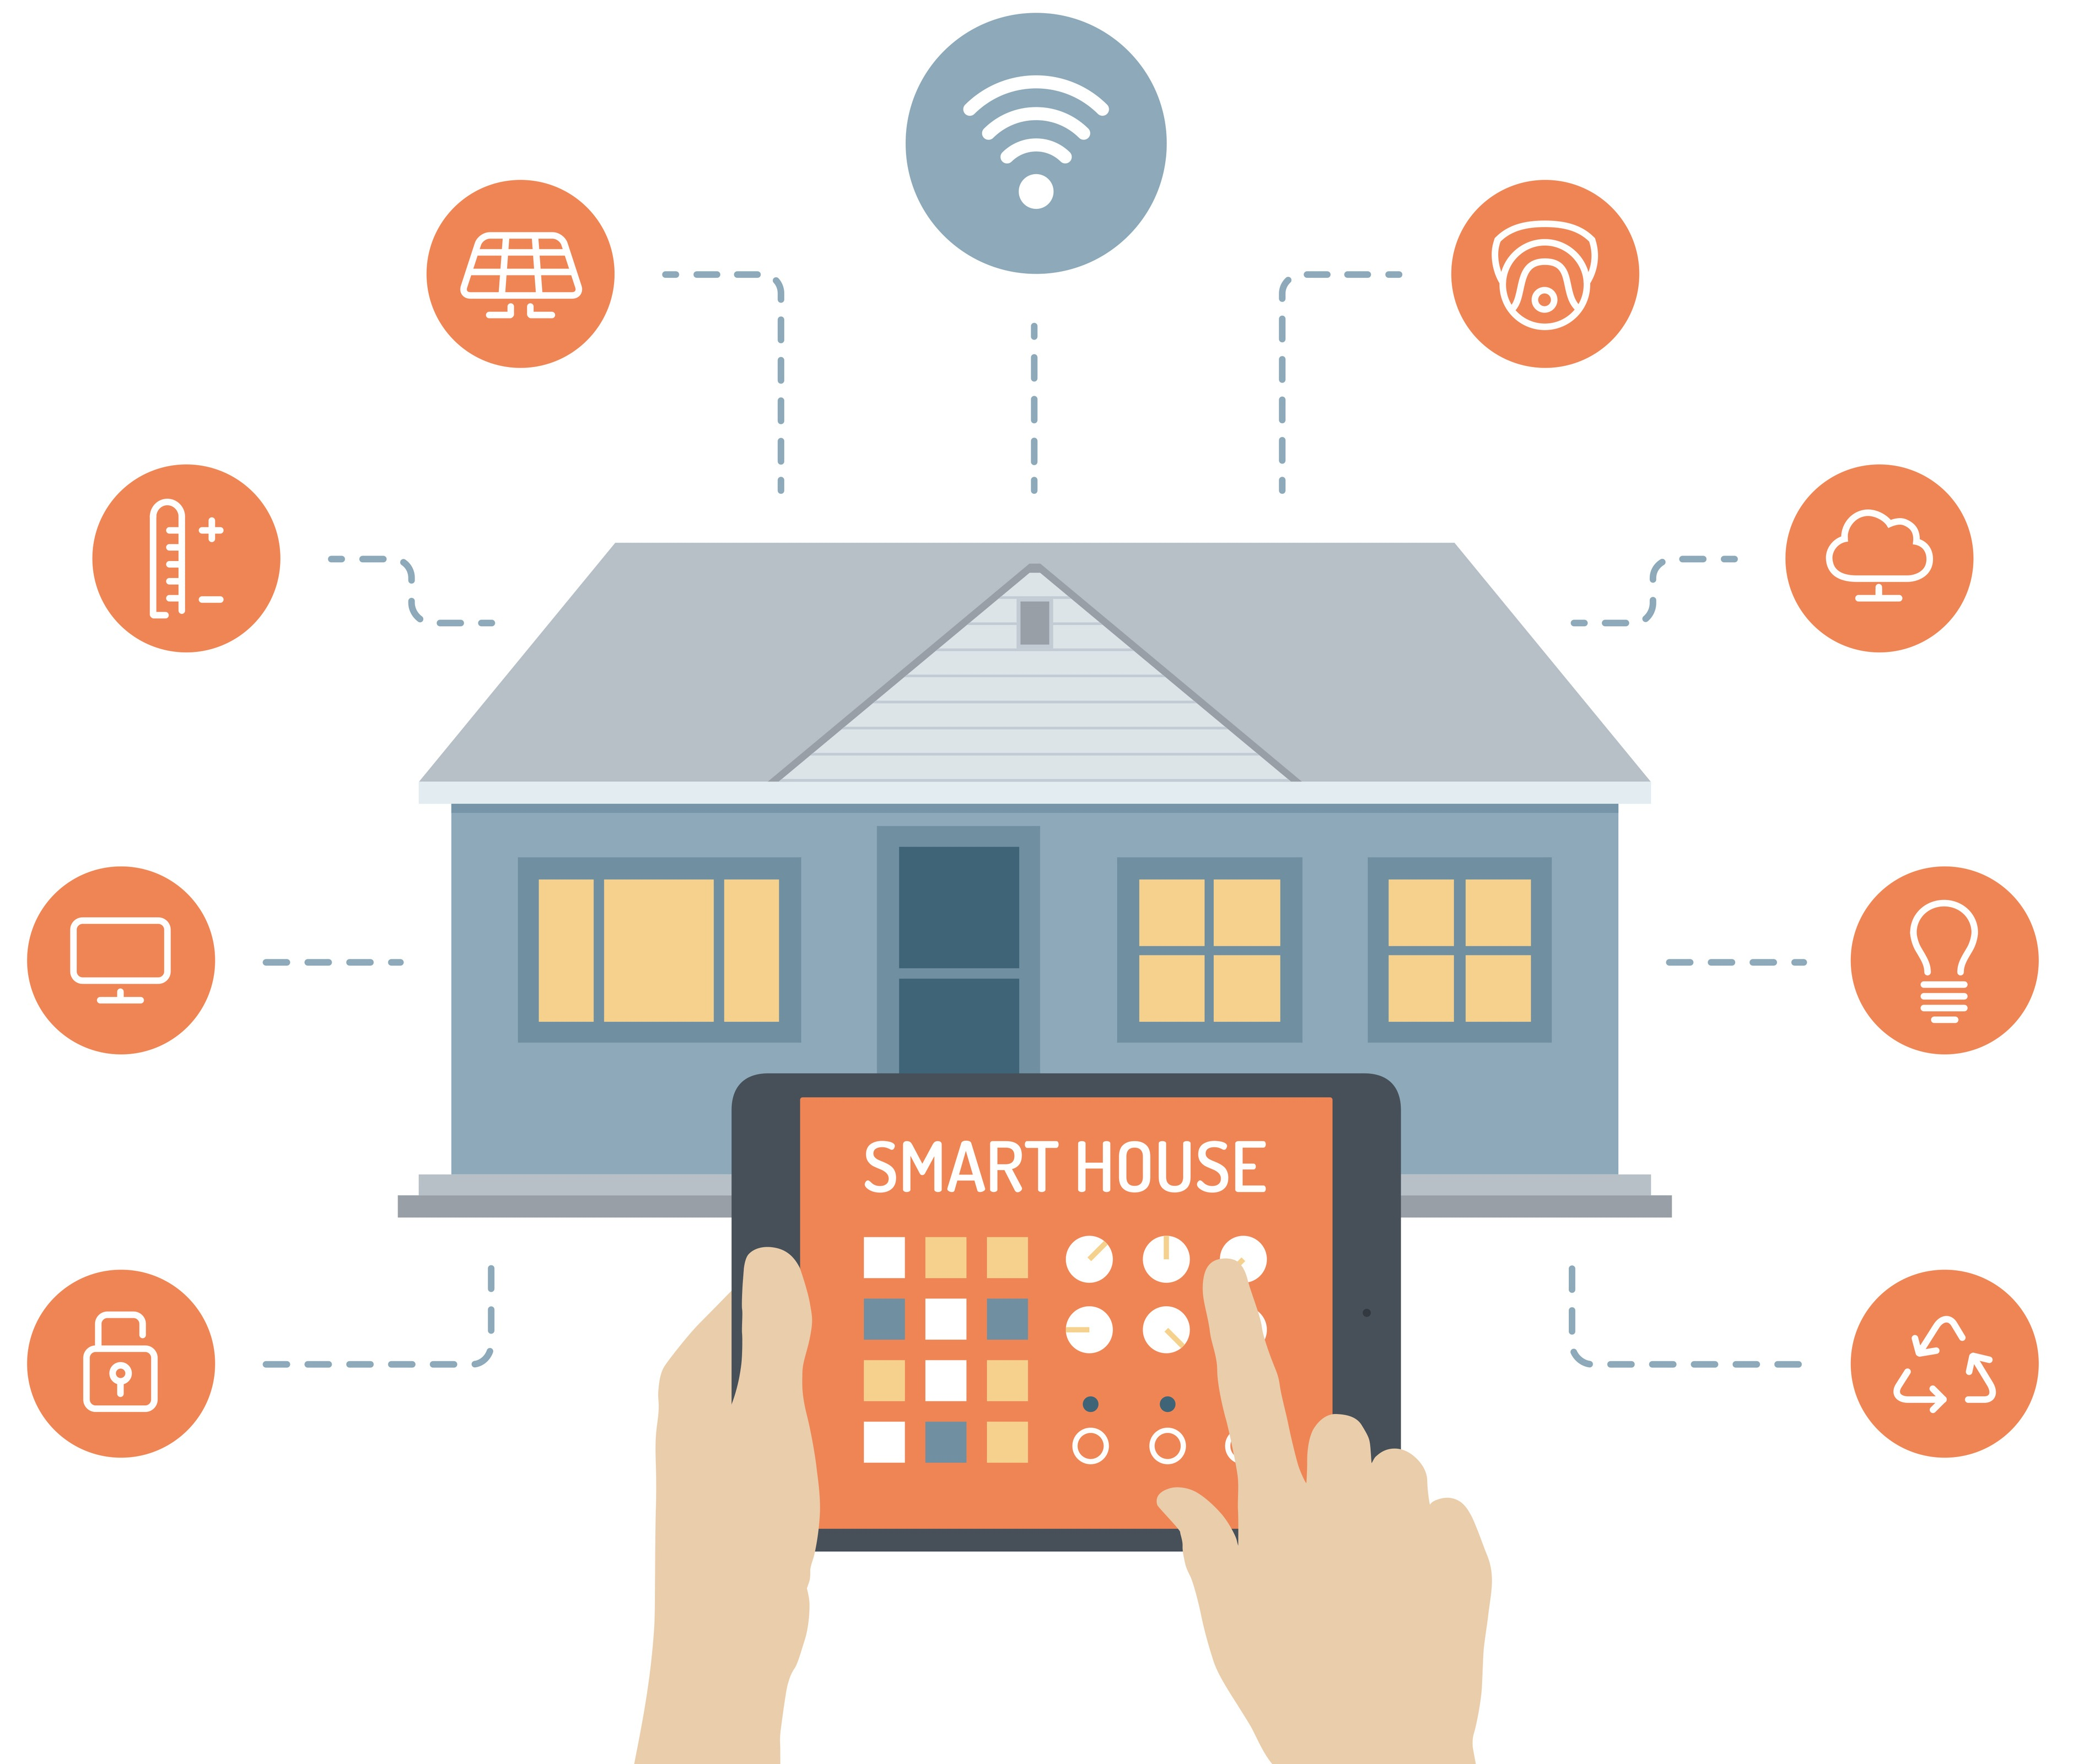
Smart Houses are Already Here!
Can we make them even smarter?
Can we encourage the society to use their full potential?
Can we educate more people to implement smarter decisions in their homes?

Slide 3

Our Life is a Game! And Sometimes it is Challenging
- Dude!
I bet you cannot sit two hours in a room with 18ºC!
Btw, the app says it will cut down your heating costs
by 10 CHF!
- Haha! Unlike you, I am hot-blooded!
Game on!

Slide 4

Challenge Your Friends for Better Living Experience!
Challenge your friends to save environment!
Help them to save their money and other resources!
Appreciate useful practices!
Live smarter and more responsible live!
Make sure your Smart House is the best!
Have fun with a new addictive game!

Slide 5
Solution: Improve Your Smart House through the Game
BetterHome
Server
Statistics
Machine Learning
Detecting abnormalities
Better practices
Recommendations
Game of Challenges
Accounts
Social part
Challenges
Motivation
Sensors
Collect data
Accept challenges
User 2 Application
Apply
recommendations
Update scores
Create challenges
User 1 Application
Sensors
Report problems
Control challenge
conditions

Slide 6
DEMO TIME!

